Slide 1
Cognos8 Transformer- OLAP Modeling
Cognos8 Transformer- OLAP Modeling

Slide 2
Topics
Transformer Development Process
Time Dimension
Working with Measures
Building a Model
Alternate Drill Downs
Customizing Power Cubes
Applying Security

Slide 3
Transformer Development Process

Slide 4
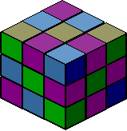
Transformer for Windows Components
Transformer - To build a model and create a cube
Transformer is a Cognos component used to define OLAP cubes structure and data (in Transformer models) and build the multidimensional analysis cubes called Power Cubes.
A PowerCube contains calculated, summarized data organized into dimensions and measures and can be viewed and analyzed in the Transformer Web Explorer, Transformer client for Windows, Transformer for Excel or Cognos 8 BI. PowerCubes provide secure and fast data access.
Keep in mind that Cognos cubes are static and building a PowerCube is a repetitive process (cubes may be refreshed every day, every month or even once a year).
The PowerCubes can be accessed and used both on-line (Transformer Web & Cognos 8) and off-line (Transformer Client).
integration * intelligence * insight

Slide 5
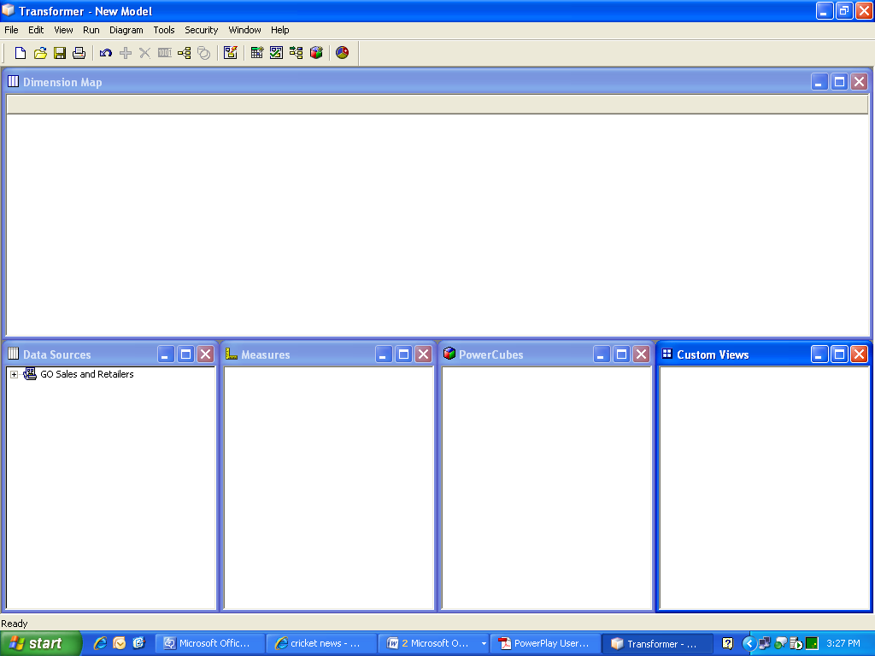
Transformer Model
  A Transformer model includes five main components
Dimension
Map
Custom View
Data Sources
Measures
PowerCubes

Slide 6
Transformer Model Components
Data Sources - List of all connected data sources. Each source can be expanded and it lists all available columns. Users can browse the source data by using Data Source Viewer. Columns from a data source window can be dragged & dropped to the dimensions and measures windows accordingly.
Dimension Map - Manages the dimensions and levels hierarchy in the data model. It allows creating new dimensions and modifying existing using an user-friendly graphical interface. Dimensions and underlaying levels are created by moving columns from the Data Sources window to the corresponding dimension column.
Measures - Drag & drop columns to manage number figures (facts) in a Transformer model.
PowerCubes - We can specify list of cubes created by the model. User Classes will define the security.
Signons - Datasource connection information.

Slide 7
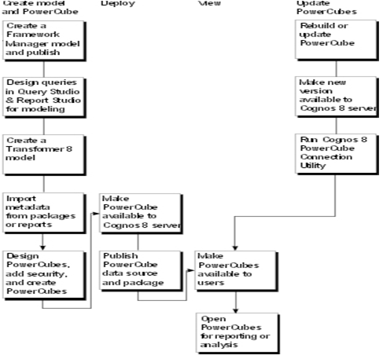
Flow

Slide 8
Transformer Development Process
The application development process in Cognos Transformer usually contains the following steps:
Gather business users requirements
Create a Model Plan which will include design and data requirements for the model and decide on the cube distribution methodology
Select measures
Plan dimensions and levels
Design and develop the Transformer model in Transformer
Create Transformer cubes and distribute them to the end users

Slide 9
Dimension

Slide 10
Dimension
A dimension is a broad grouping of data about a major aspect of a business, such as products, dates, or markets.
There are two types of dimensions:
  Regular dimension : A regular dimension contains descriptive and business key information and organizes the information in a hierarchy, from the highest level of granularity to the lowest..
  Time dimension : Time dimension contains date levels arranged in descending order. The date levels are usually some combination of Year, Quarter, Month, Week, or Day.

Slide 11
Creating the Time Dimension
Time dimension is a special type of dimension.
Cognos provides an automatic support for handling time dimensions which is working very well.
To create a time dimension, you can use any of the following methods:
Use the Date wizard.
Transformer prompts you for information about the time dimension and then creates the dimension for you.
Manually create a new time dimension and then successively drag the required date columns to each level in the dimension.
Set the appropriate date function and other date-related properties for each level.
Drag the time dimension source category from the Data Sources list to the dimension map.

Slide 12
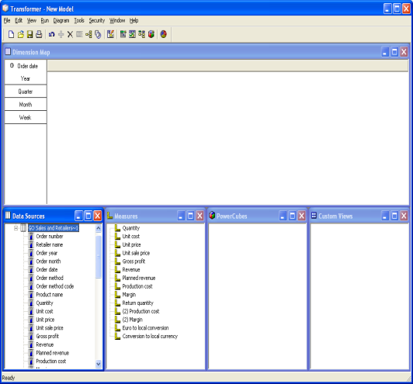
Creating the Time Dimension
This automatically creates a time dimension with the standard levels Year, Quarter, and Month Design the dimension before you have any items in the Data Sources list.
Insert a new dimension, setting the dimension type to Time. When you specify names for the source columns in the Date Level Creation dialog box and you are warned that the column do not exist, click OK. From the Run menu, click Generate Date Categories.

Slide 13
Working with Measures

Slide 14
Measures
A measure is the data used to gauge the performance of your business, such as sales revenue, profit margin, and number of sales reps.
The main types of measures are as follows:
  A regular measure, which takes data directly from a source column available in the data source. A regular measure is numeric data in a transactional data source.
  A calculated measure, which derives new numeric data for measures when no direct source column is available.
** A model can contain any number of regular or calculated measures, together with logical grouping that use measure folders.

Slide 15
Regular Measure
A regular measure is numeric data in a transactional data source
Each model contains one or more regular measures
The specified query items, including measures, are retrieved from the data sources specified in your model
After your cubes and data sources are published, authorized users can access the resulting cubes and OLAP reports for analysis
To add a regular measure, drag the column from the Data Sources list to the Measures list

Slide 16
Calculated Measure
A calculated measure is new numeric data that is derived from other measures, functions, and constants, such as Profit, which is calculated from the measures Revenue and Cost
You can specify the format for the result, and also explain the calculation in the Description box on the Measure property sheet, so that your users can see how the data was derived.
When you use a calculated measure, you can have the measure calculated before or after rollup.
Values for measures calculated before rollup are based on source values instead of summed values, and are rolled up separately.

Slide 17
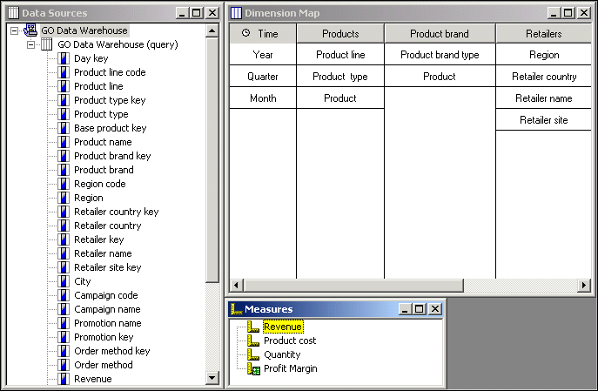
Example for an Measure
In model, the Measures list contains both regular measures (Revenue, Product cost and Quantity) and a calculated measure (Profit Margin).

Slide 18
Define a Measure Folder
Measure folders can represent logical groupings of lower-level measures, or they can be calculated measures without any lower-level measures. That is, the calculation of a folder-level measure does not have to reflect the total value of the measures contained within that folder. The measures can be independent of each other from a calculation point of view.

Slide 19
Steps to Add a Measure Folder
Right-click the Measures pane and click Insert Measure Folder.
In the Measure name box, type a name for the measure folder.
The measure name must be unique in the model. By default, the measure name is derived from the original name of the associated source column and the Short name and Measure label options are set to <<From Measure Name>>.
Drag existing measures into your new measure folder.

Slide 20
Rollup
The Rollup function specifies how measure values are summarized, or rolled up, from child categories to their parent categories. Summarization occurs when your OLAP reporting component displays measure values in categories above the lowest level of detail.
When the type of rollup used is specified in the Description box on the Measure property sheet, other users can reference this information.

Slide 21
Types of Rollups
The three kinds of rollup are as follows:
Regular rollup combines records with identical values in non-measure columns. It is applied to the time dimension by default unless the Time state rollup option is specified for the measure.
Time state rollup combines records with identical values in the time dimension according to the Time state rollup function selected.
Duplicates rollup is automatically used whenever the PowerCube Consolidation option is selected.
If you select both Regular rollup and Time state rollup, regular rollup is performed first, followed by the time state rollup.
When a model has more than one time dimension, you cannot use time state rollup.

Slide 22
Building a Model

Slide 23
Creating a new model (cont’d)
A Transformer Model can be also created using a wizard with AutoDesign function or manually. We strongly recommend to avoid the AutoDesign function as in most cases it does not provide the results expected.
From the File menu, click New to open the New Model wizard.
In the Model Name box, enter a name for your model.
If you plan to control data access by means of user class authentication, select the Include
Security in this Model check box.
Click Next and enter the name of your initial data source in the Data Source Name box.
Select a Source Type from the list, and click Next.

Slide 24
Creating a new model (cont’d)
7. Depending on the selected type, Transformer shows different options. Enter the parameters that correspond to your data source.
8. On the last page of the New Model wizard select the Run AutoDesign option to have Transformer create a preliminary structure for you, or you can clear this check box and create your own design.

Slide 25
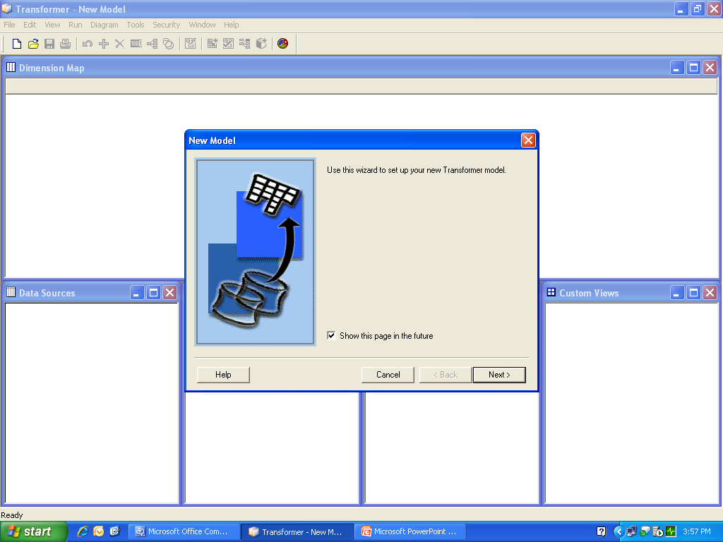
Creating a new model (cont’d)

Slide 26
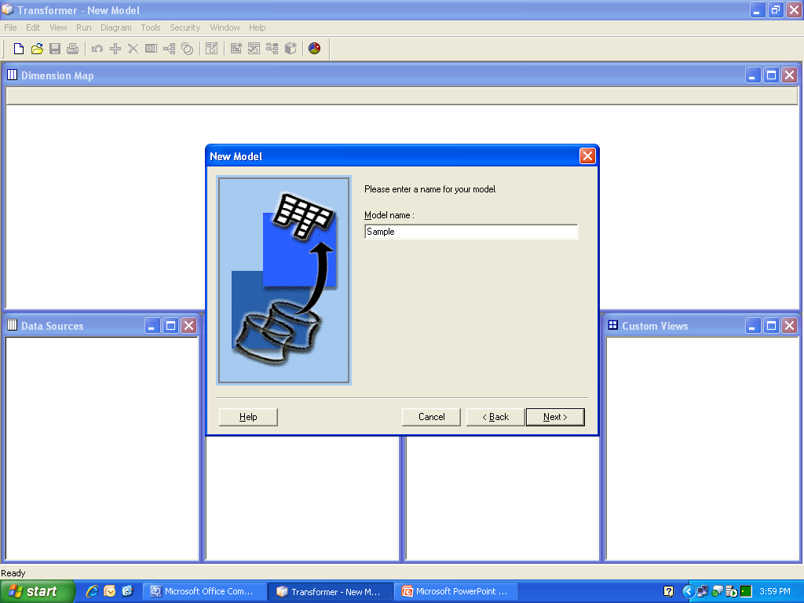
Creating a new model (cont’d)

Slide 27
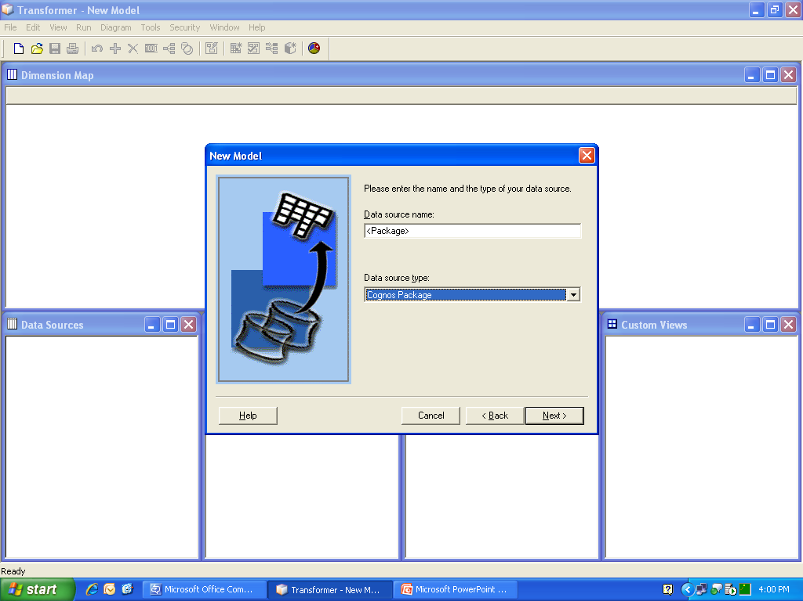
Creating a new model (cont’d)

Slide 28
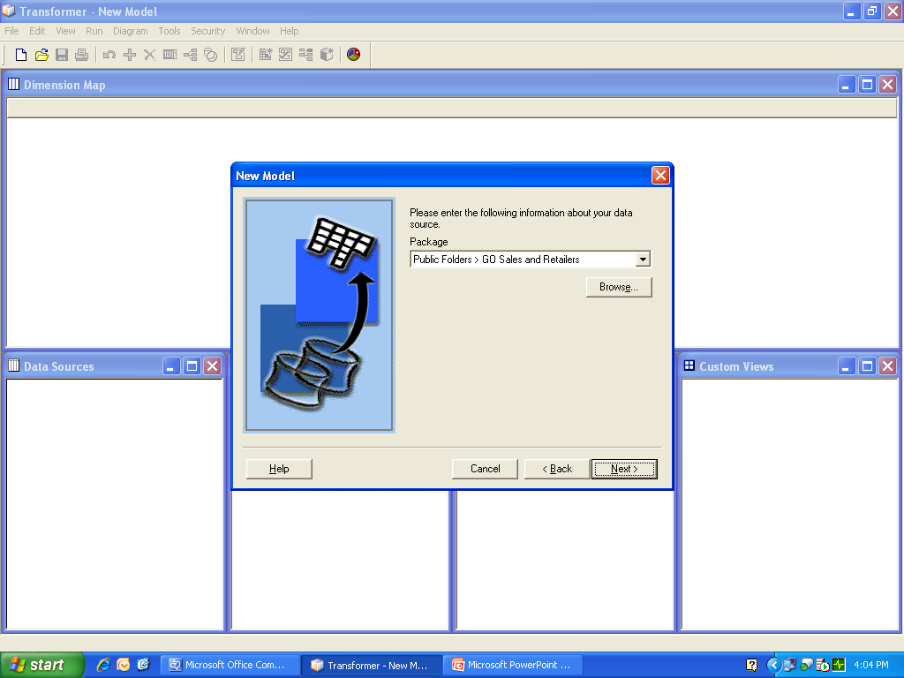
Creating a new model (cont’d)

Slide 29
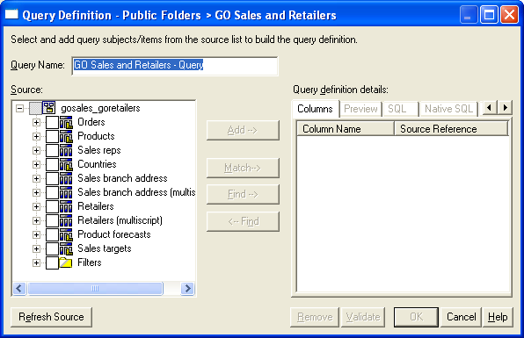
Creating a new model (cont’d)

Slide 30
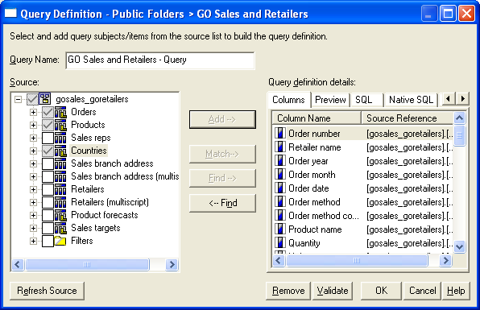
Creating a new model (cont’d)

Slide 31
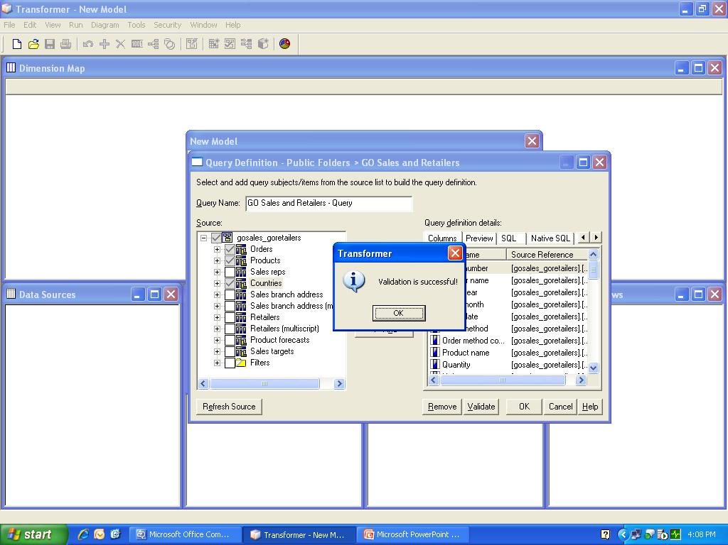
Creating a new model (cont’d)

Slide 32
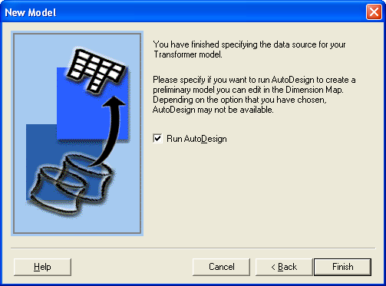
Creating a new model (cont’d)

Slide 33
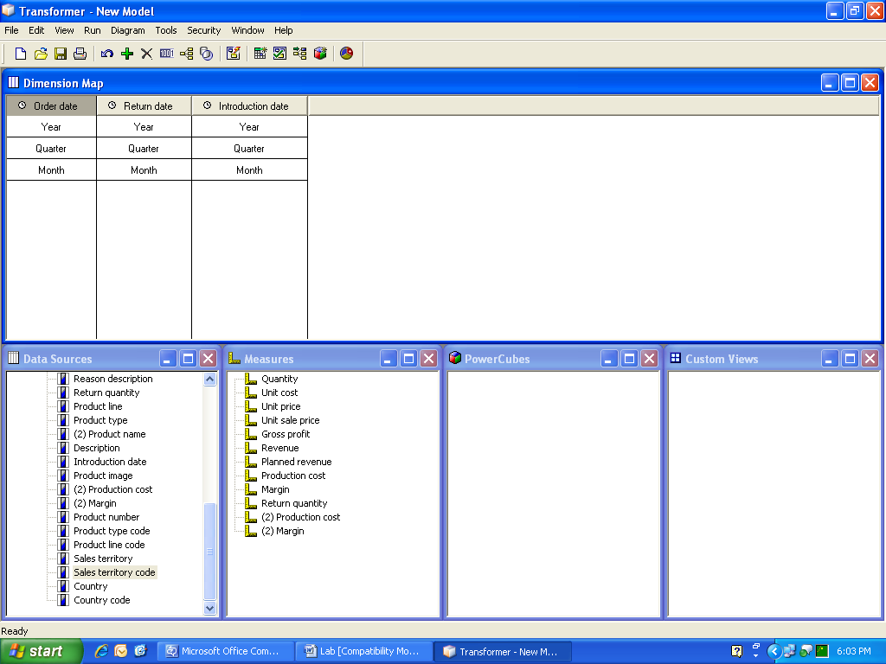
New Model Created

Slide 34
Alternate Drill Downs

Slide 35
Drill Down
Organizing the data in your model into meaningful hierarchies enables your OLAP report users to analyze the business information at various levels of detail. Each dimension consists of one or more drill-down paths that typically contain several drill-down levels

Slide 36
Alternate Drill Downs
An alternate drill-down structure in a dimension to provide a different perspective on the data.
Transformer prompts you to confirm uniqueness when you create an alternate drill-down path..
Since the category values at the convergence level and below are shared by all drill-down paths, any change affects the same category in all other drill-down paths.

Slide 37
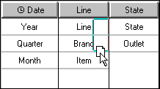
Steps to create an Alternate drill down path
In the dimension map, select the level that is to be the convergence level for the new alternate drill-down path and, from the Edit menu, click Create Drill-Down. Alternatively, drag a column to the dimension map, as shown in the following image
If appropriate, add intermediate (manual) levels to the new drill-down path.
To ensure you have not introduced uniqueness problems, from the Run menu, click Check Model.

Slide 38
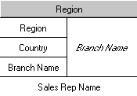
Convergence level
The convergence level is the level at which an alternate drill-down path connects to the primary path.
Each convergence level must have unique categories
Convergence level

Slide 39
Customize Power Cubes

Slide 40
Types of Power cubes
Time-based Partitioned Cube
Time-based partitioned cubes are a collection of child cubes, based on one level in the time dimension, that together form one large cube. Each child cube is partitioned, or split, at the appropriate reporting level, such as quarter or month.
Update Cubes Incrementally
It is best to place frequently updated data in one or more separate data sources, so that you can perform incremental updates to quickly add the latest changes to your existing cube.
integration * intelligence * insight

Slide 41
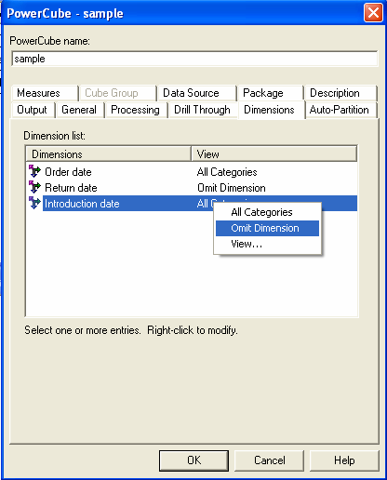
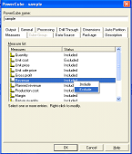
Customize Power Cubes
You can customize a Power Cube for specific user requirements by:
  Excluding and including specific dimensions and measures from a Power Cube.
  Include and Omit Dimension:-Use to specify whether to include a measure in the cube or cube group and Omits the entire dimension
  If you exclude a measure that is required to derive a calculated measure. Transformer includes the measure in the cube for calculation purposes only. The excluded measure is not visible to Transformer users.

Slide 42
Different Power Cube Settings
Auto Partitioning
Specifies the estimated number of records the cube will contain.
There is a performance trade-off between faster cube creation in Transformer and faster data access in the reporting components.
Specifies the preferred maximum size for each partition in the cube.
Specifies the maximum number of times Transformer reads the source data during partitioning.
Processing
Specifies the current status of the cube, Stores summaries for the first crosstab in the cube, to accelerate cube opening in the reporting components. when categories have been excluded from a custom view, to exclude data that would represent an inaccurate rollup of only non-excluded categories.
Drill Through
Allow Drill Through for this Power Cube, Sets up drill-through in Transformer.

Slide 43
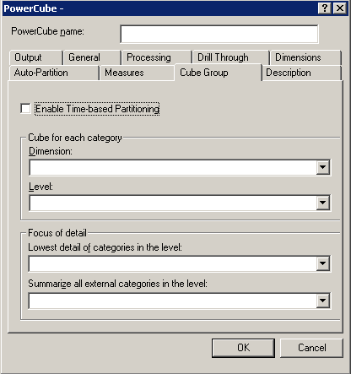
Cube Group
Cube groups where the child cubes are intended for different users, and so contain different dimension views or subsets of the query objects defined in your model. You can also improve performance by setting up time-based partitioned cubes.

Slide 44
Applying Security

Slide 45
Security
Transformer supports simultaneous user authentication and logon using the full range of supported Cognos 8 security providers.
You can also add custom views to each Power Cube to grant or deny access to sensitive business intelligence information.
Access controls can be customized down to the query object level: not merely to reports and cubes, but to the specific levels, categories or members, and measures within them.

Slide 46
Types of Security
Transformer supports two types of security to restrict data access across the Cognos 8 reporting components
Member-based security, you create custom views and apply these views to specific categories (members), dimensions, or components thereof. This filters the cube data that is shown to specific report users. Member-based security uses security objects such as users, groups, or roles, to define user access to information.
Cube-based security, you apply security to an entire PowerCube or cube group by setting a password to restrict access to authorized users.

Slide 47
Users
A user entry is created and maintained in a third-party authentication provider to uniquely identify a human or a computer account.
Information about users, such as first and last names, IDs, passwords, locales, and e-mail addresses, is stored in the third-party authentication providers.
Users can become members of groups defined in third-party authentication providers and groups defined in Cognos 8. A user can belong to one or more groups. When users are members of more than one group, their access permissions are merged; this is known as the union of views principle.

Slide 48
Custom Views
Member-based security to a model is implemented by custom views of the data, the same is replicated to individual cubes.
While creating a custom view, you select security objects (users, groups, and roles) configured in your Cognos 8 namespaces, and then define a specific view of the data for those security objects using dimension filtering methods, such as apexing or cloaking.
The security you specify for an object is passed on to the drill-though reports that reference that secured object. Only users with permission to see the secured object are able to see it in the published cube.
With Transformer, you can also create hierarchical custom views.
Notes:
Hierarchical custom views allow you to restrict the data accessible in the descendant views, without having to recreate full custom views.

Slide 49
Thank you

